Slide 1
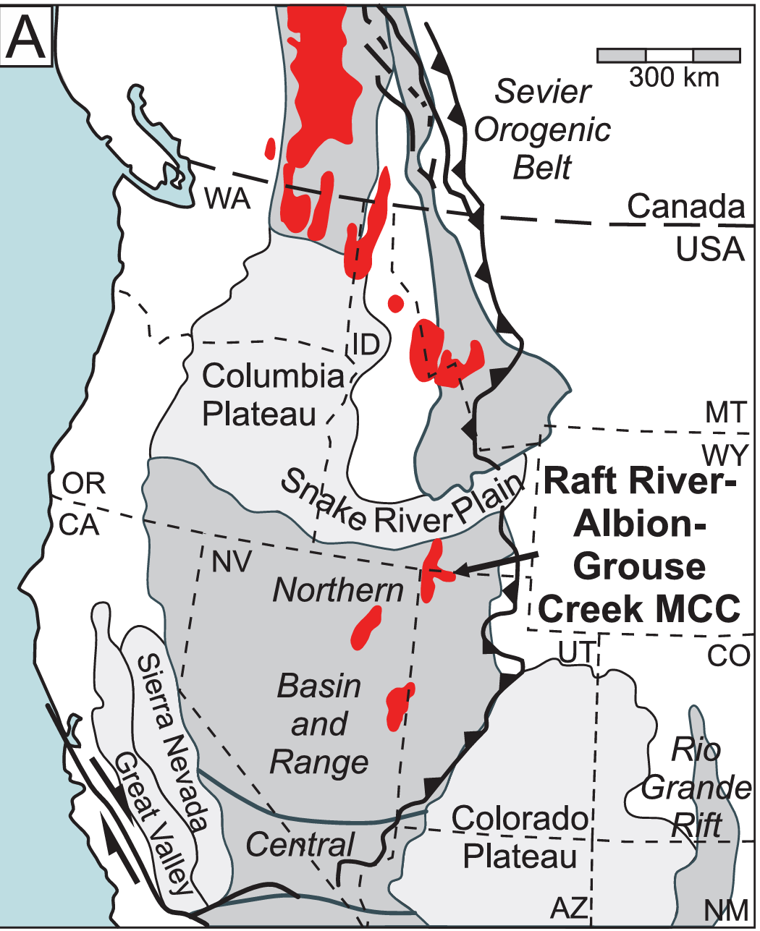
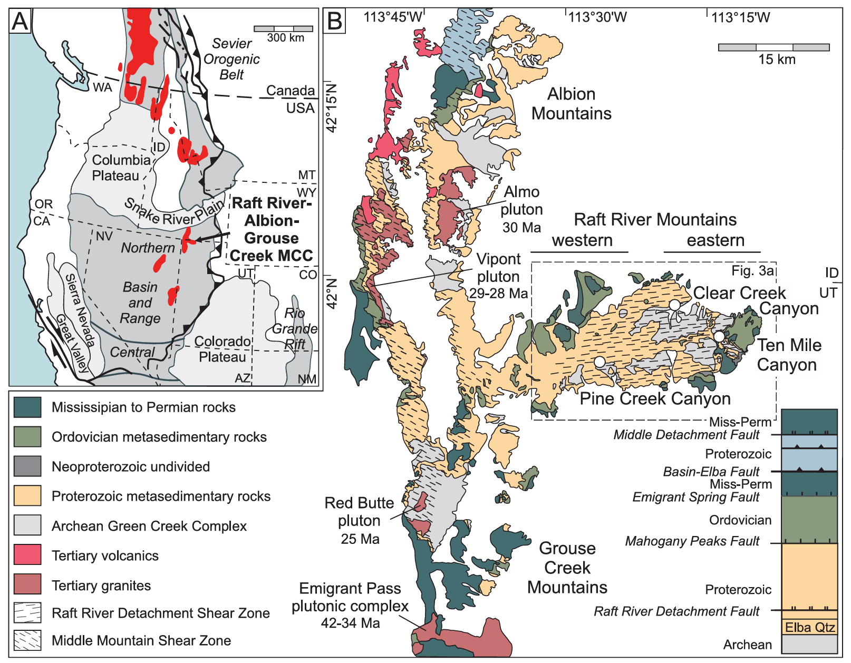
Core Complex Formation in the Great Basin
Methner et. al. 2015
Ryan Parkyn

Slide 2
Study Area
Northwestern Utah in Raft River Mountains
MCC -> Metamorphic core complex
Raft River-Albion-Grouse Creek MCC
(RAG-MCC)

Slide 3
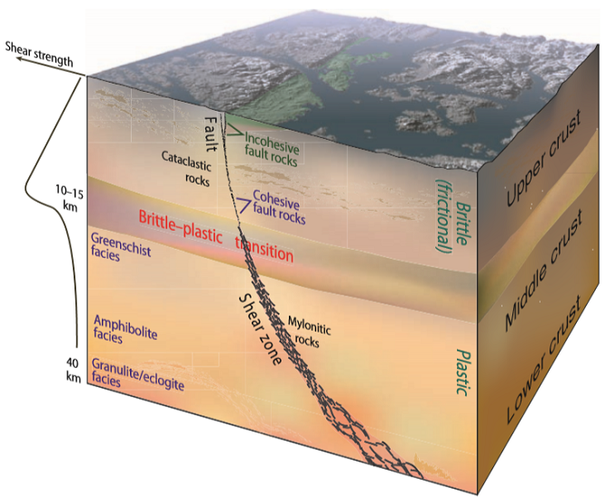
Study Area
MCCs development -> Sevier orogeny produced over thickened crust (thin skinned) -> extension exhumed basement rocks in low angle detachment faults
Footwall of MCC
Problem: MCC
fabrics are severely
overprinted

Slide 4
Methods
Mylonite: Deformed rock that has undergone grain size reduction due to plastic deformation
Muscovite contains hydrogen and oxygen, changes when mineral alters due to change in T or if hydrated

Slide 5
Methods
Pine Creek Canyon, Clear Creek Canyon,Ten Mile Canyon
40Ar-39Ar ages of muscovite
Hydrogen isotope concentrations of muscovite
Oxygen isotope concentrations of muscovite
Temperatures based on H isotope
Muscovite:
KAl2(AlSi3O10)(OH)2

Slide 6
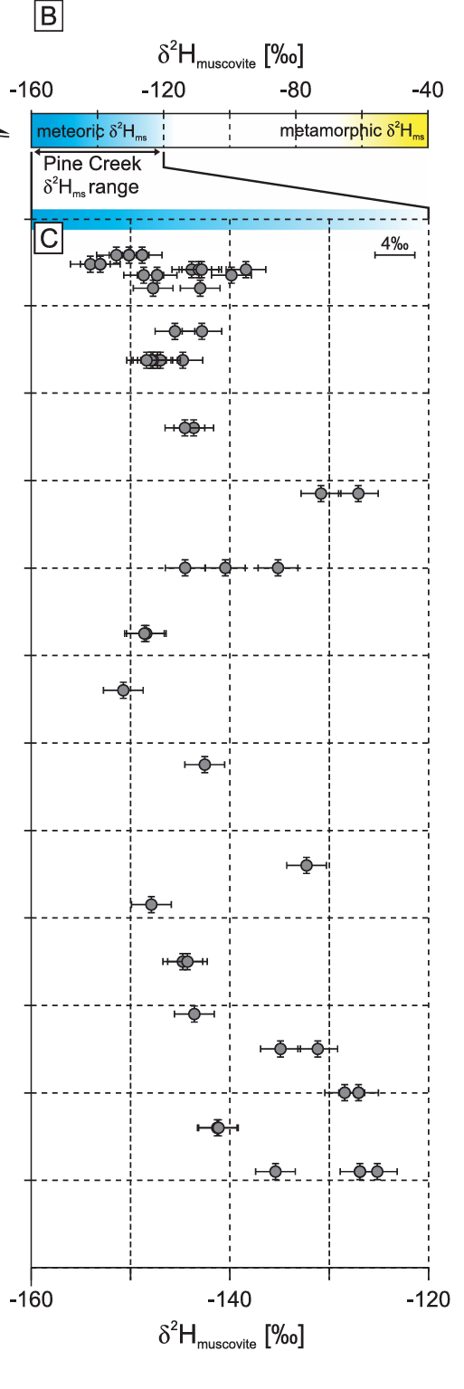
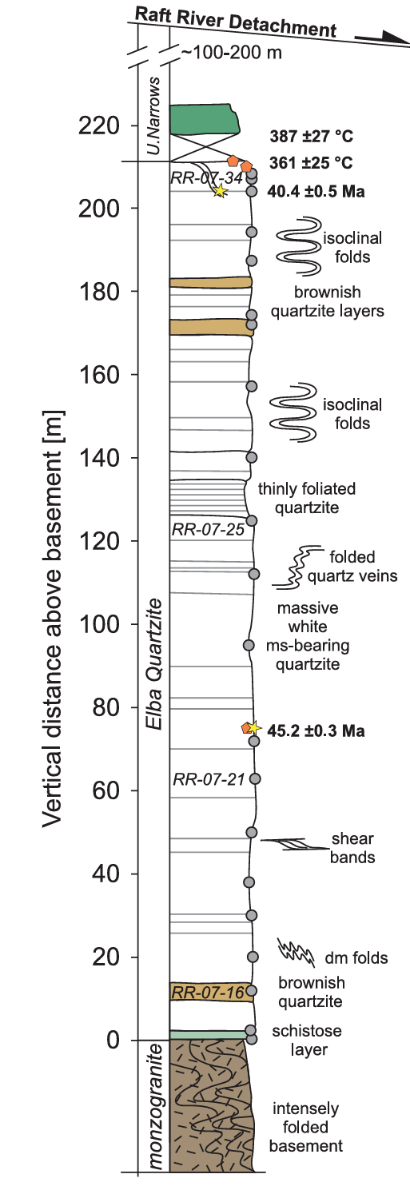
Calculated through hydrogen isotope fluid compositions (Fluids present during DRX)
Stars = Ar-Ar geochron ages
Pentagons = oxygen isotope exchange thermometry
Circles = hydrogen isotope
Note -80 to -40 delta hydrogen values are a metamorphic signature and -160 to -120 are meteoric
Hydrogen isotopes in muscovite from mylonitic zone show an interaction with meteoric water during deformation

Slide 7
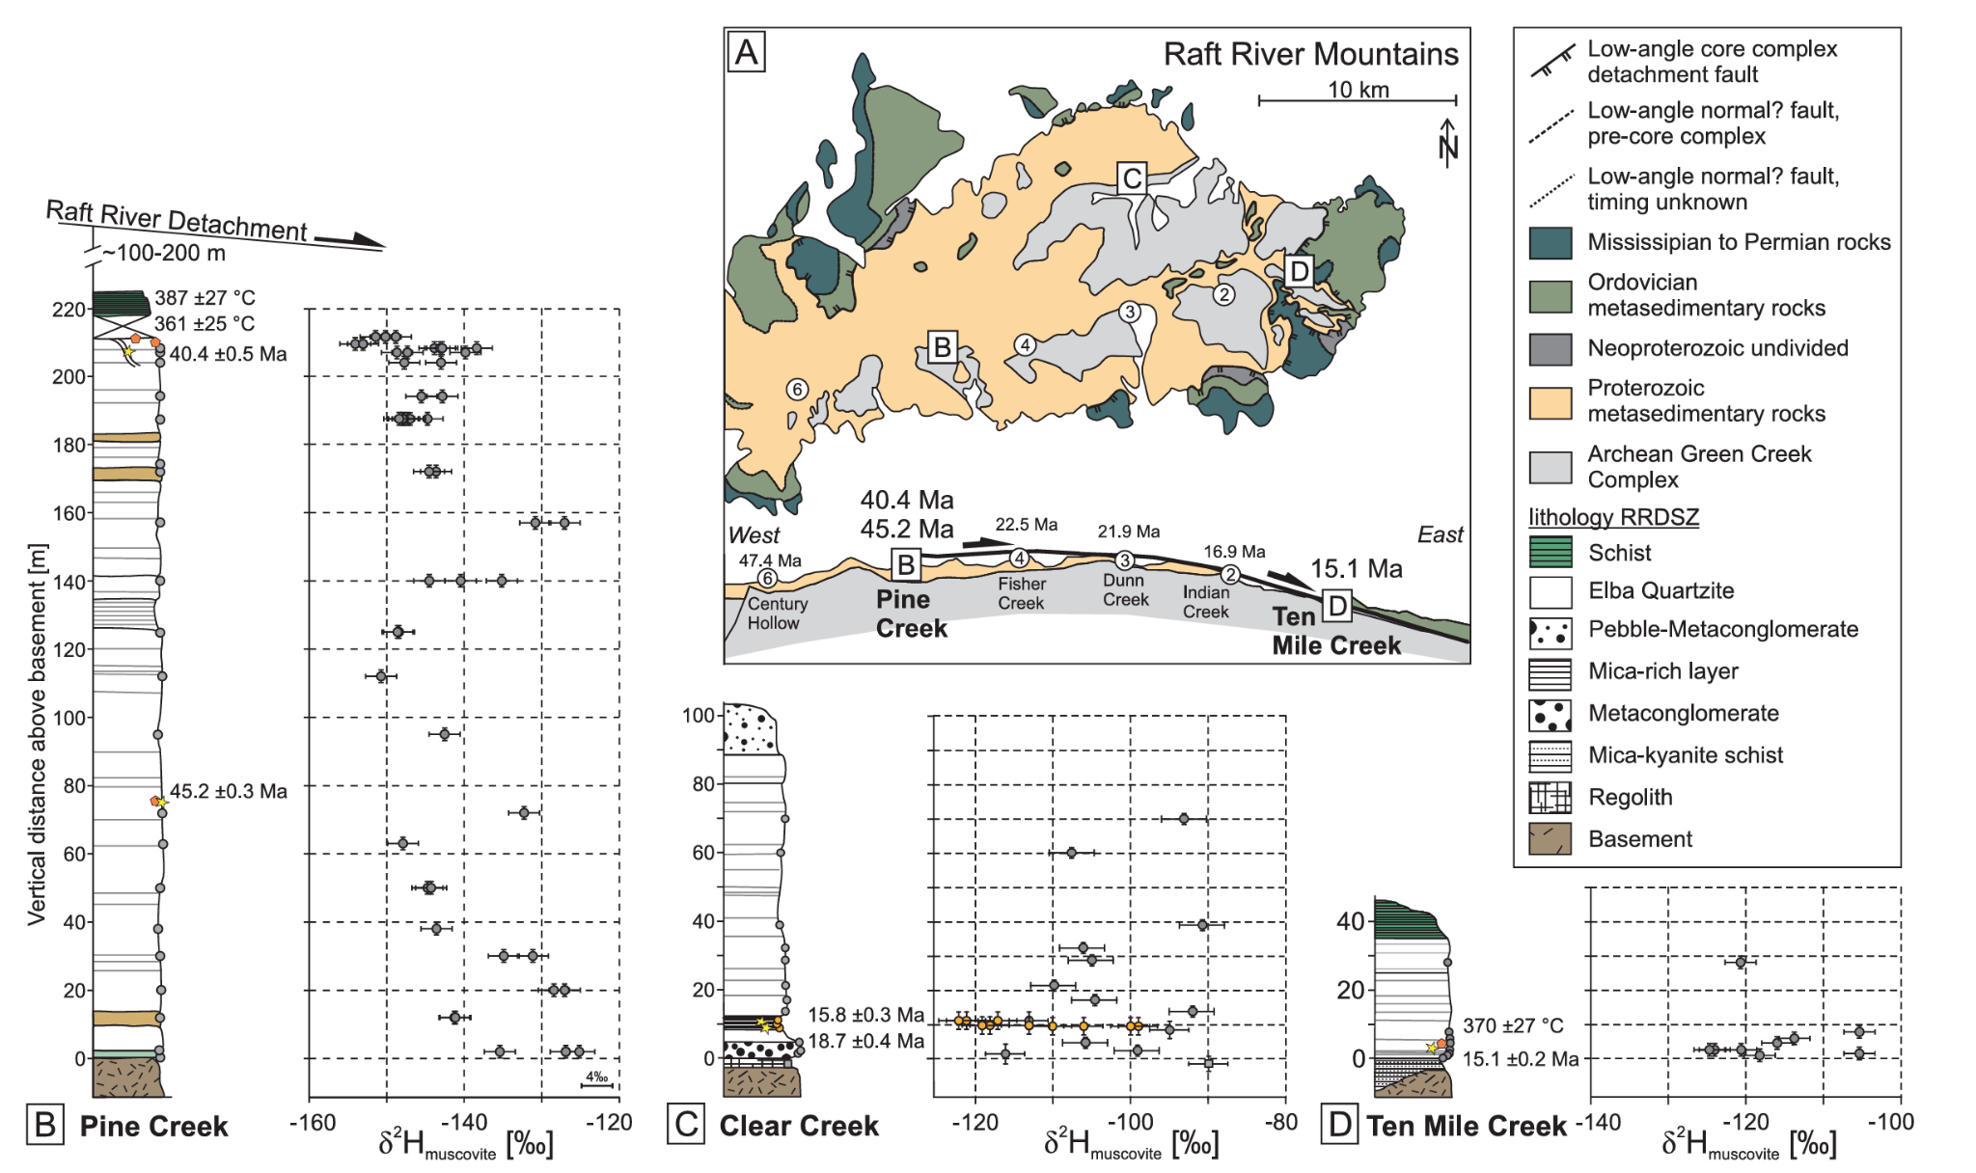
t

Slide 8
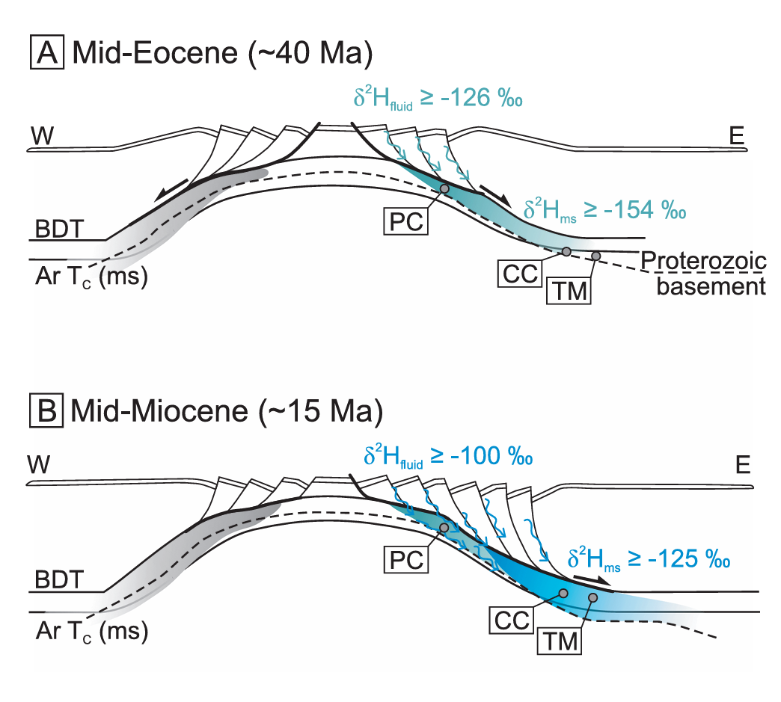

Slide 9
Conclusions
1) Delta 2 hydrogen concentrations are low in muscovite meaning a synkinematic meteoric water influence
2) 374+/-37C at greenschist conditions, consistent with petrological and microstructure observations
3) Recrystallization of mica at 40.4+/-0.5 Ma, subsequent phase of deformation was active until 18-13 Ma (hydrogen isotopes differ)

Slide 10
t

